Slide 1
Online Banking system

Slide 2
Tech stack used
1. flask
2. sql server
3. sql alchemy
4 . bootsrtap

Slide 3
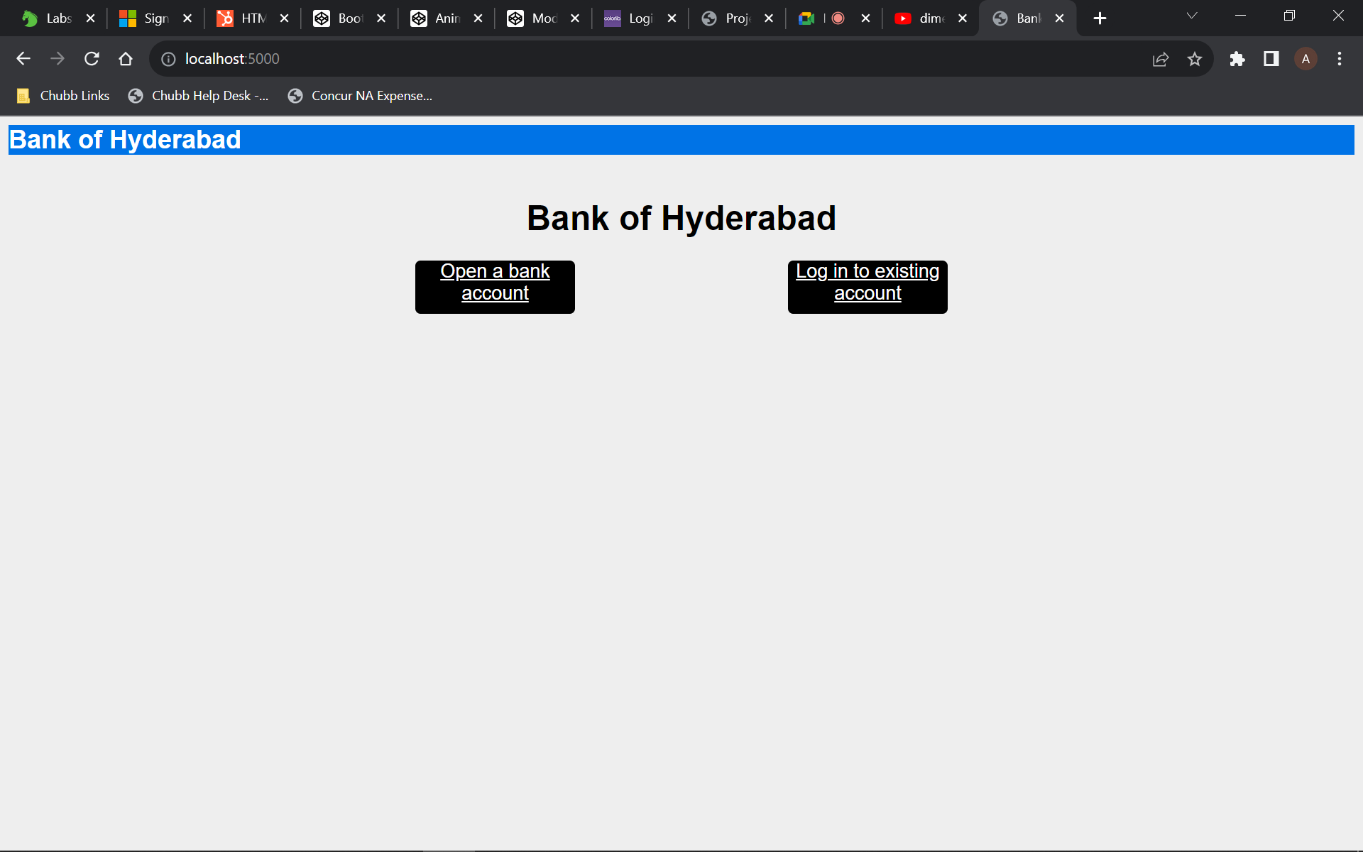
homepage
Home page has 2 options : new account opening and login into existing account

Slide 4


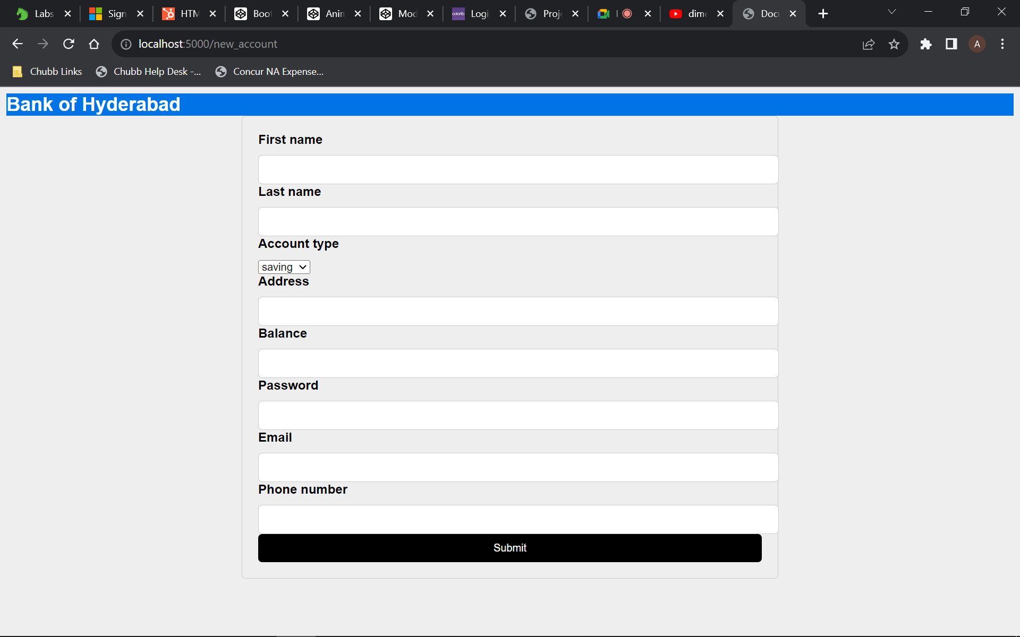
Account opening form
In the account opening form , the new users have to enter following details:
Address
First name
Last name
Balance
Email id(which is going to be their username also to login)
Password
Phone number ( optional )
Account type

Slide 5
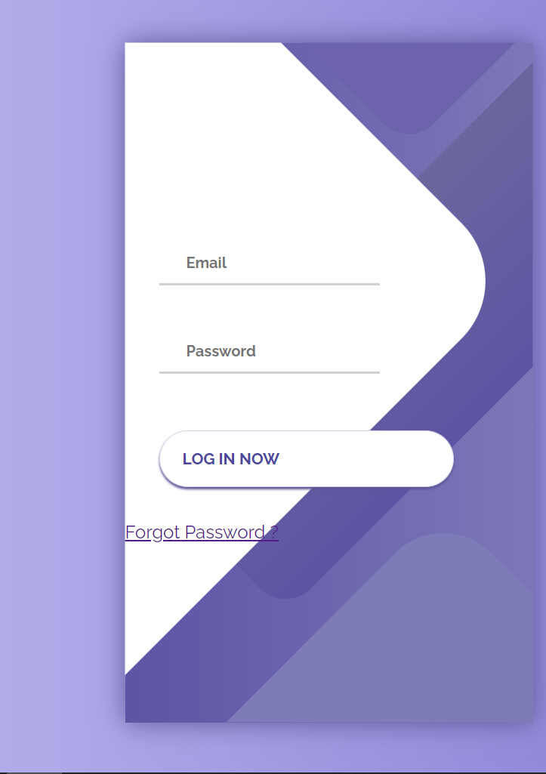
The login to your account
The user logins through his email and passoword
There is also forgot password option

Slide 6
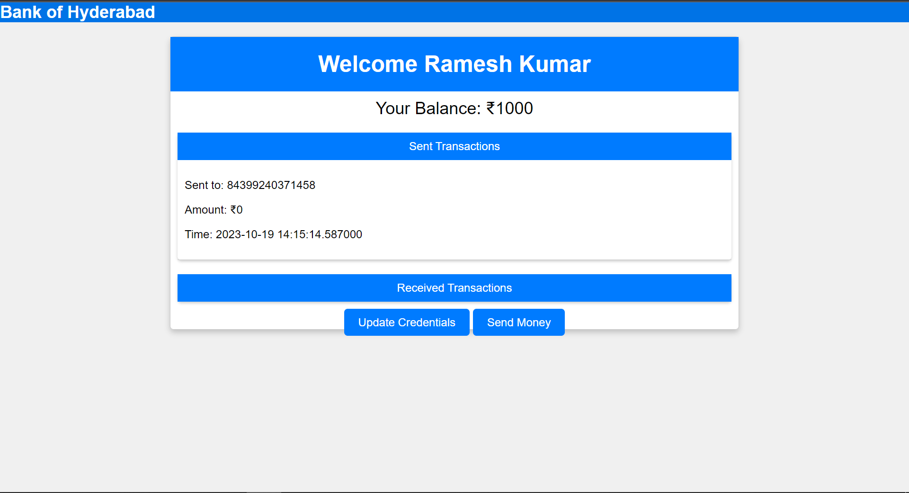
dashboard
Dashboard displays the user details such as recent transactions
It also has the option to send money and also update credentials

Slide 7
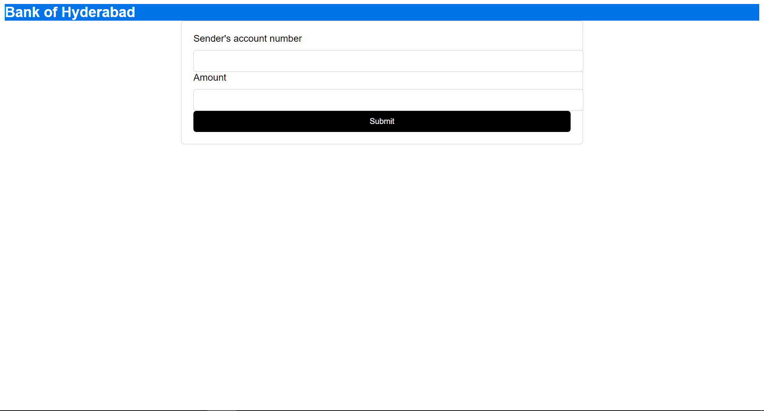
Send money feature
In send money feature , u just give the account number of the person u want to send money and the amount

Slide 8
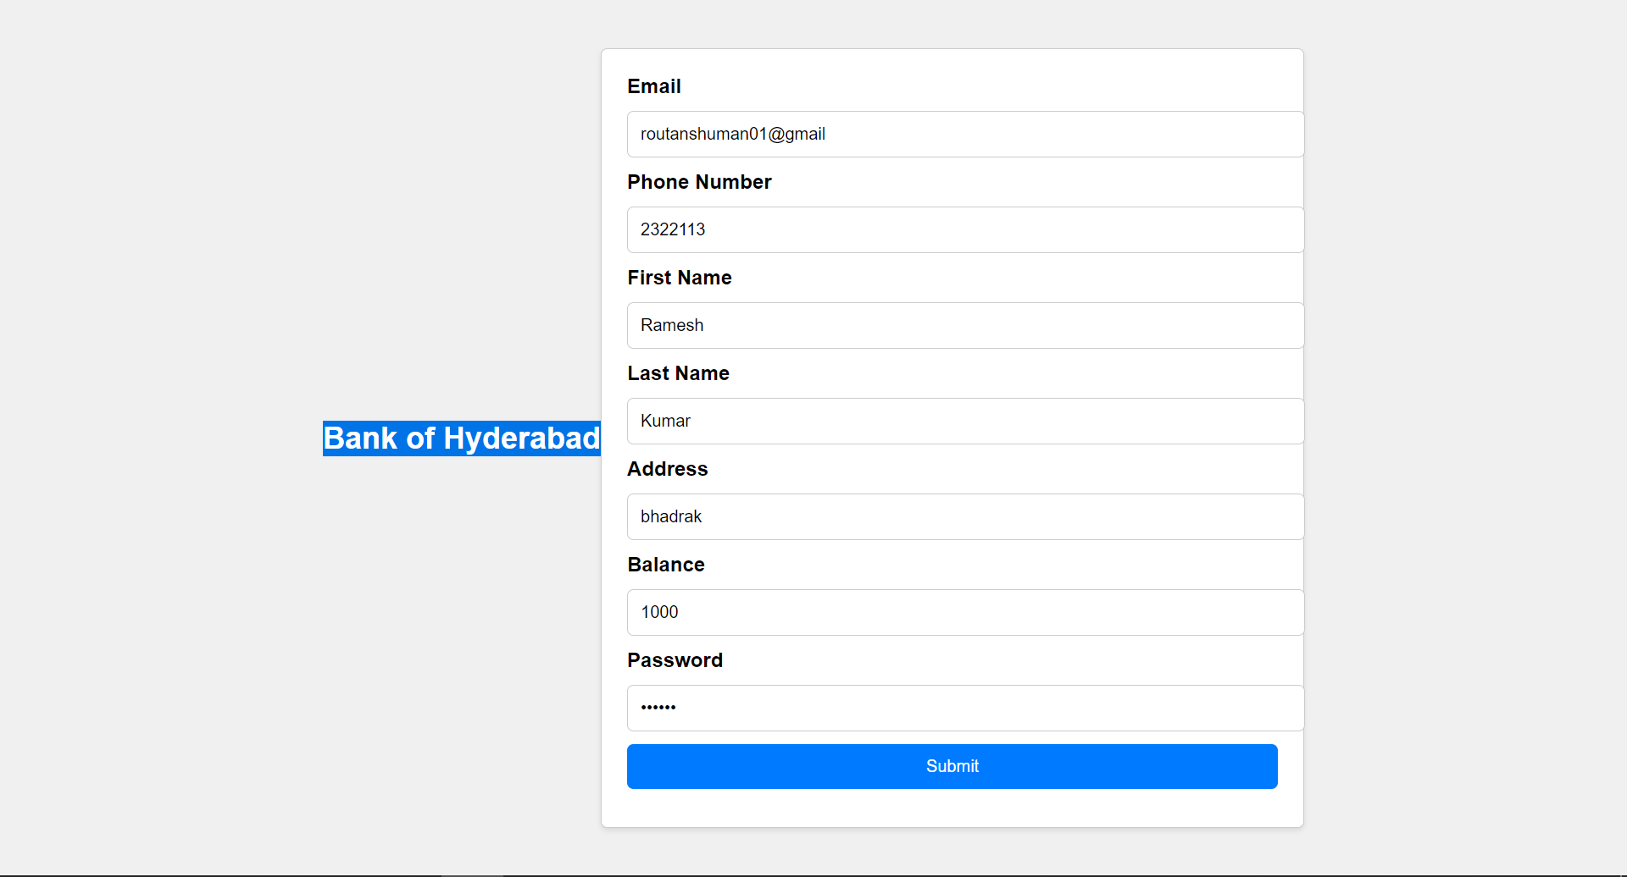
Update credentials
For update credentials feature , u just click on update credentials button
It will open a form with already populated values which you can simply edit(if u want) and submit

Slide 9
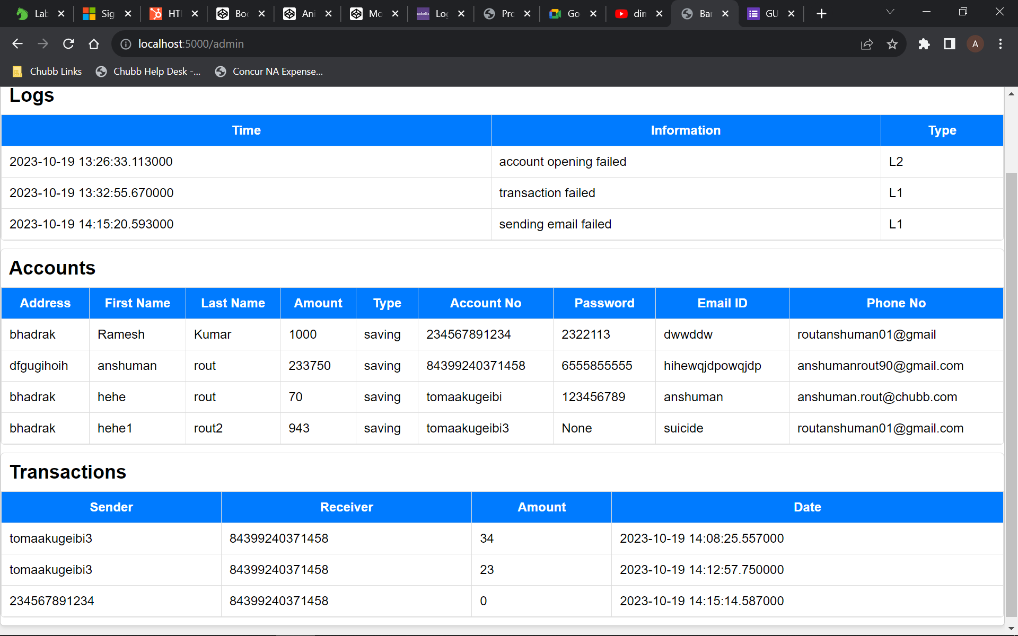
Admin panel
Admin panel contains
System logs
Recent transactions
Account informations

